Slide 1
Effects of extreme climate events on avian demographics
P. Heglund, A. Pidgeon, R. Akcakaya, T. Albright, A. Allstadt, B. Bateman, C. Flather, J. Gorzo, W. Thogmartin, S. Vavrus, A. Venegas, and Volker C. Radeloff
University of Wisconsin-Madison

Slide 2
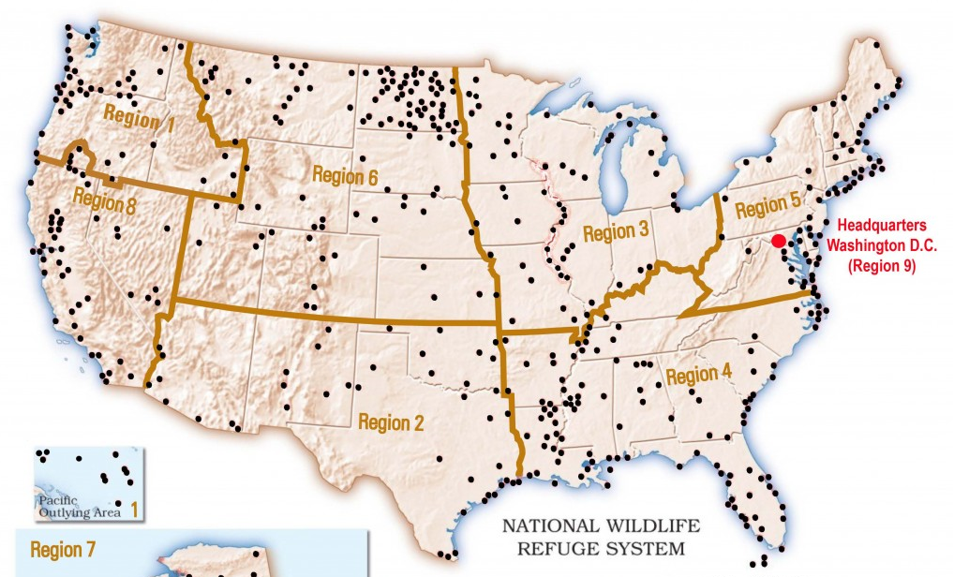

Slide 3
Extreme event
Die
Move
Chicks
Adults
Emigrate
Concentrate

Slide 4
Outline
What are fine-scale patterns of climate extremes?
Which refuges will see increases in which extremes?
How did and how will birds respond to extremes?
And what about Monarch butterflies?

Slide 5
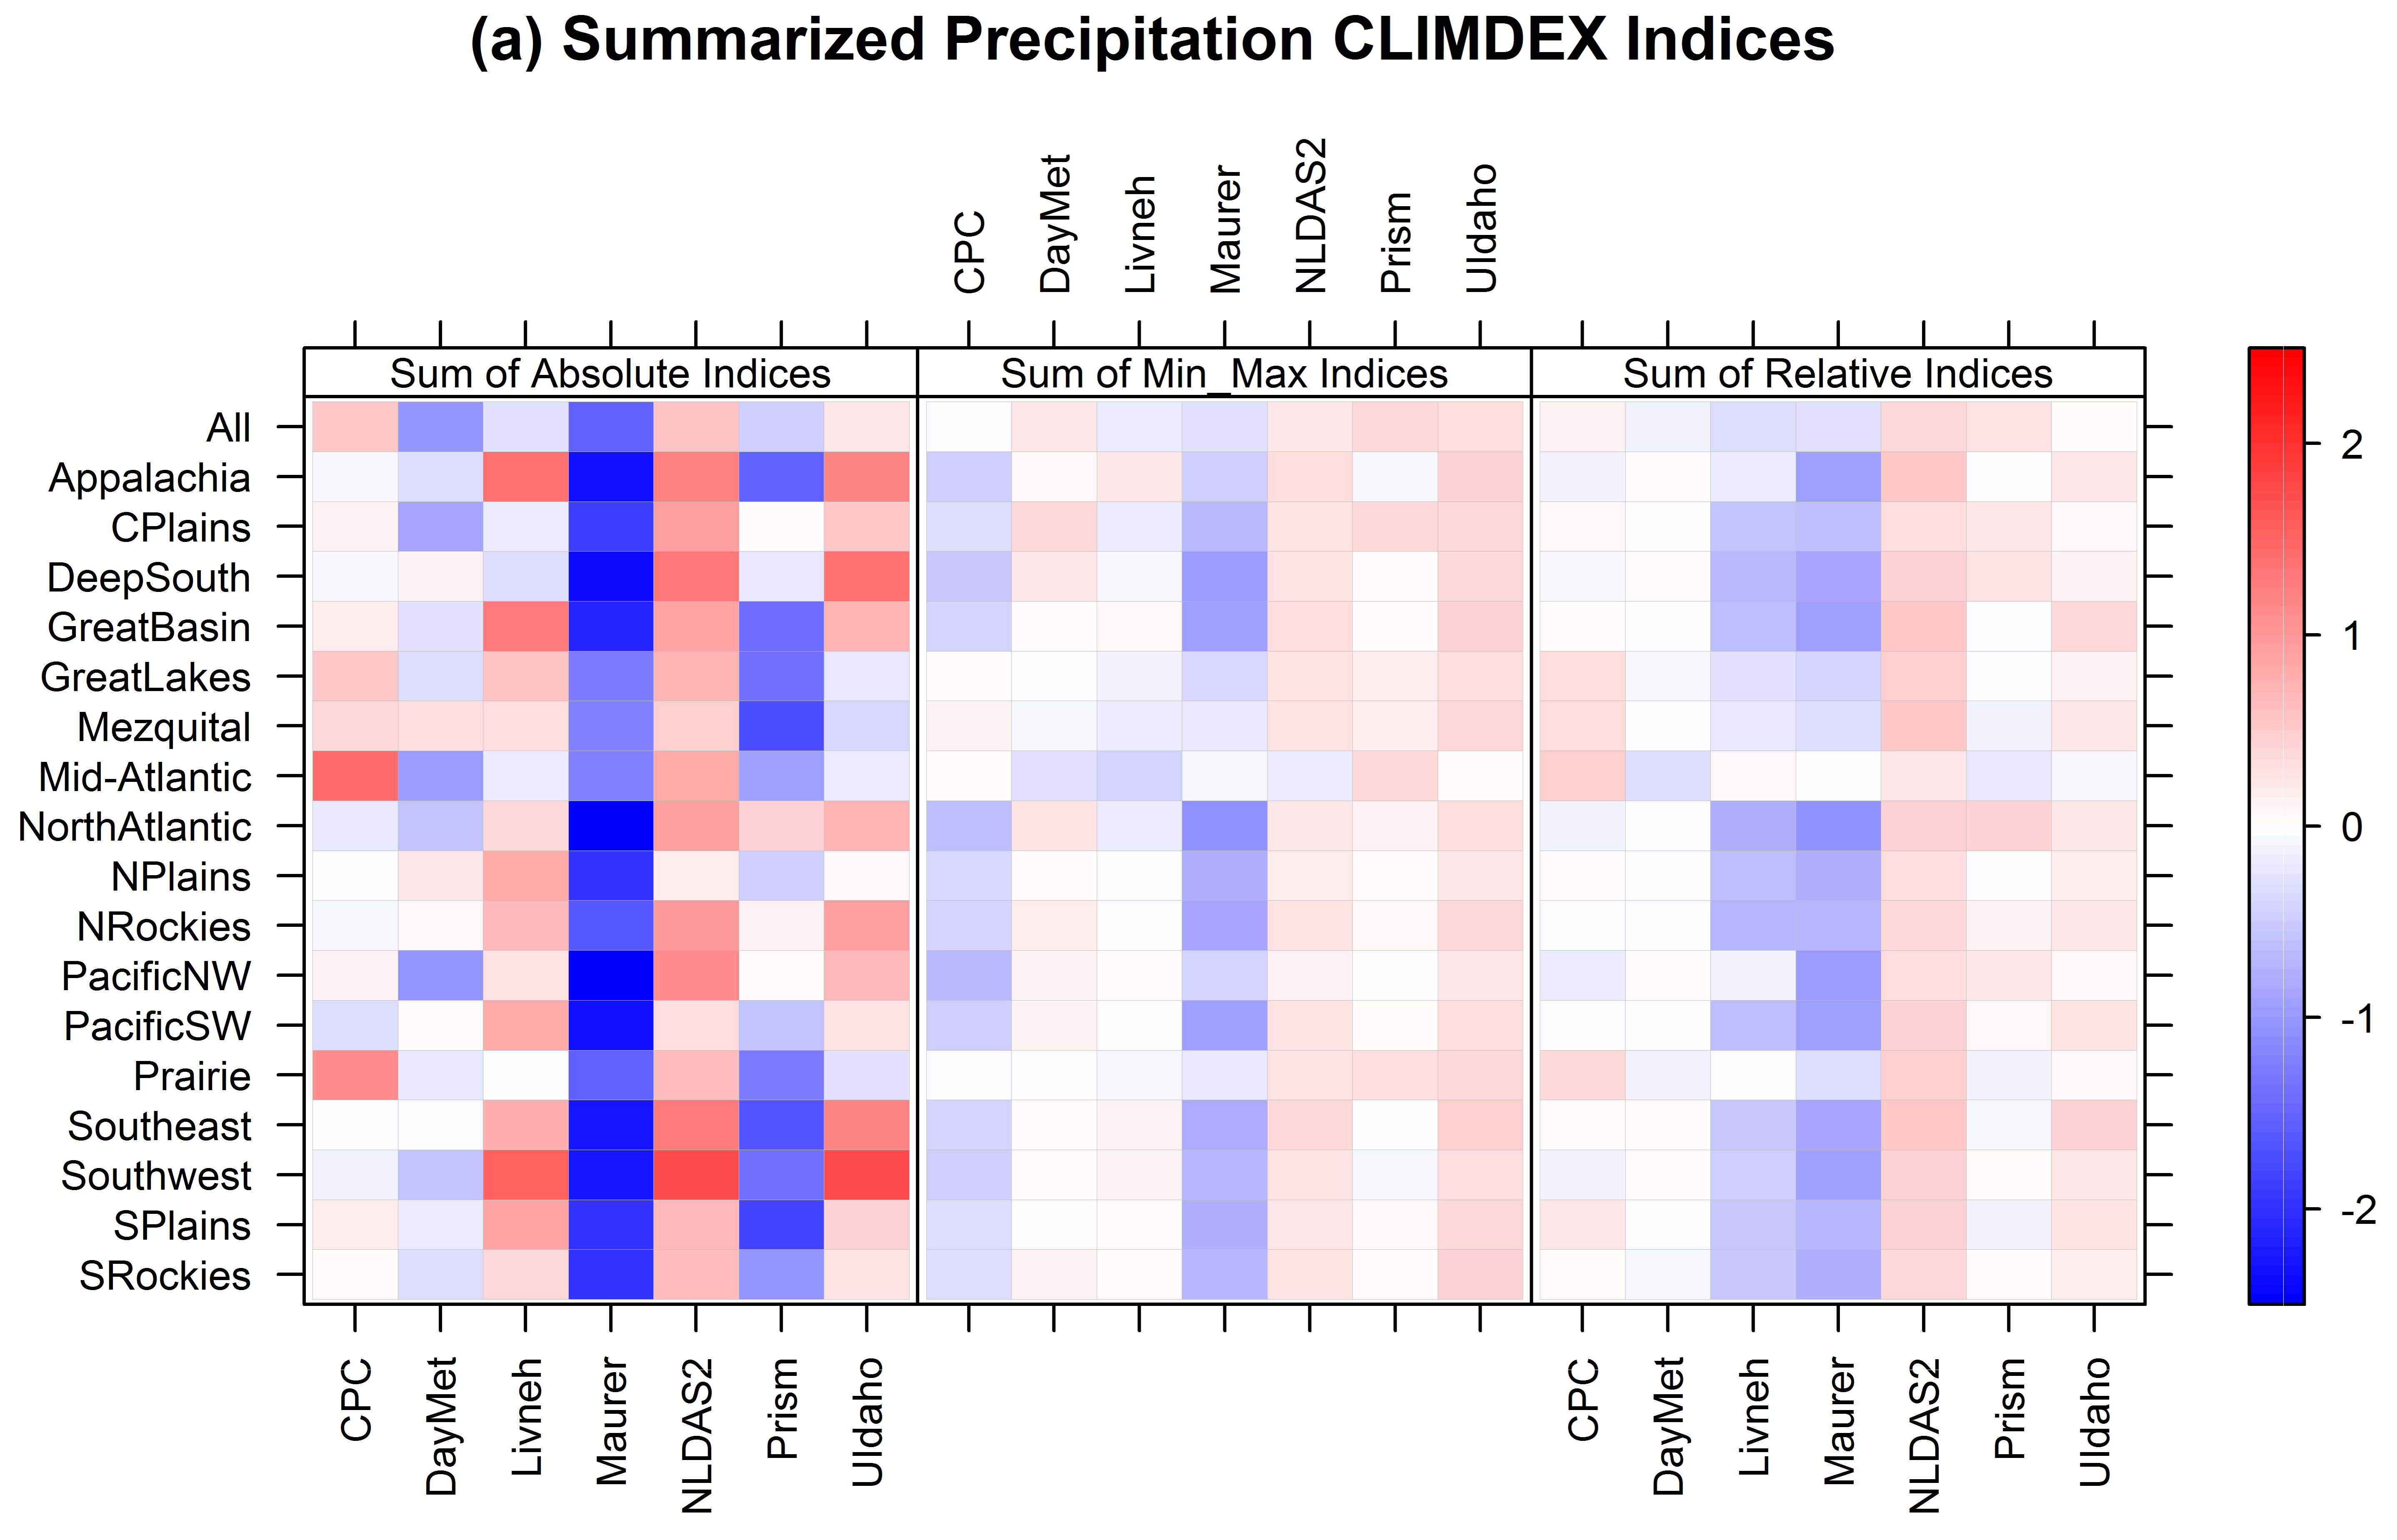
Behnke et al.

Slide 6
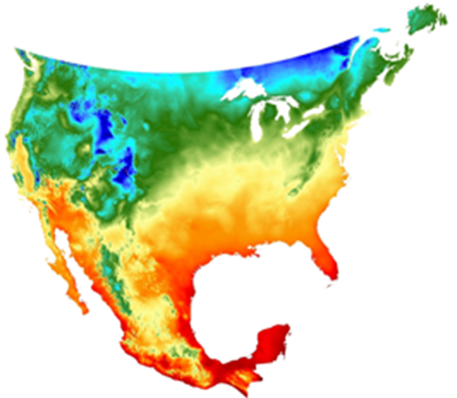
Daymet Historical Weather Data
Weather stations interpolation
1980-2013
1 km
Daily
Allstadt et al.

Slide 7
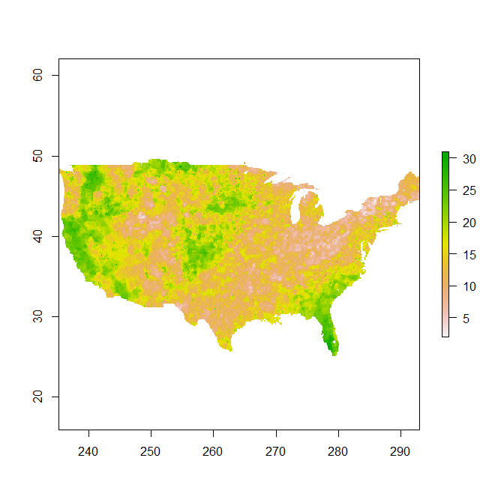
Maurer Historical Weather data
Weather stations interpolation
1949-2010
12 km
Daily
Allstadt et al.
Notes:
Talk about format

Slide 8
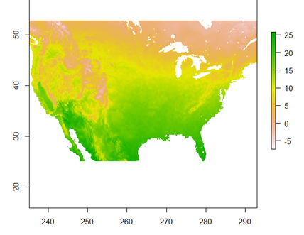
BCCA Downscaled Climate Model Output
Debiased and downscaled based on Maurer dataset
19 CMIP5 GCMs
1950-2100
12 km
Daily
Scenarios
RCP45 (2006-2100)
RCP85 (2006-2100)
Allstadt et al.

Slide 9
Extreme weather data
BIOCLIM (19 variables)
Monthly weather summaries
CLIMDEX ETCCDI Indices
Standardized Precipitation Index (SPI)
Standardized Temperature Index
Spring Phenology and False springs
Allstadt et al.
Notes:
These are all the weather variables we’re using, at least ones derived from weather data.
BIOCLIM – Typically these are “climate” variables calculated over 30 year periods or so, which we wouldn’t consider measures of extreme. But Brooke uses them at an annual scale which can measure shorter term changes.
Monthly Summaries – means, std dev, # dry days, total precipitation, etc.
CLIMDEX ETCCDI Indices – Widely used measure of extreme weather, determined by an expert panel. Includes annual measures like the number of frost days/tropical nights, growing season length, measures of precipitation intensity, etc.
ETCCDI - Expert Team on Climate Change Detection and Indices
“ClimdEX is a project that produces a suite of in situ and gridded land-based global datasets of indices representing the more extreme aspects of climate. Indices are derived from daily temperature and precipitation data using the definitions recommended by the CCl/CLIVAR/JCOMM Expert Team on Climate Change Detection and Indices” Standardized Precipitation Index – Widely used measure, a standardized precipitation anomaly allows comparisons among locations. Customizable to time period during year of interest. Standardized Precipitation Evapotranspiration Index – Same deal, except uses precipitation deficit, which incorporates the effect of temperature on water availability. Standardized Temperature Index – Analogous measure to the previous, but for . Standardized temperature anamolies are widely used, we just call it this for consistency. Spring Phenology and False Springs – You’ll talk about later in more depth

Slide 10
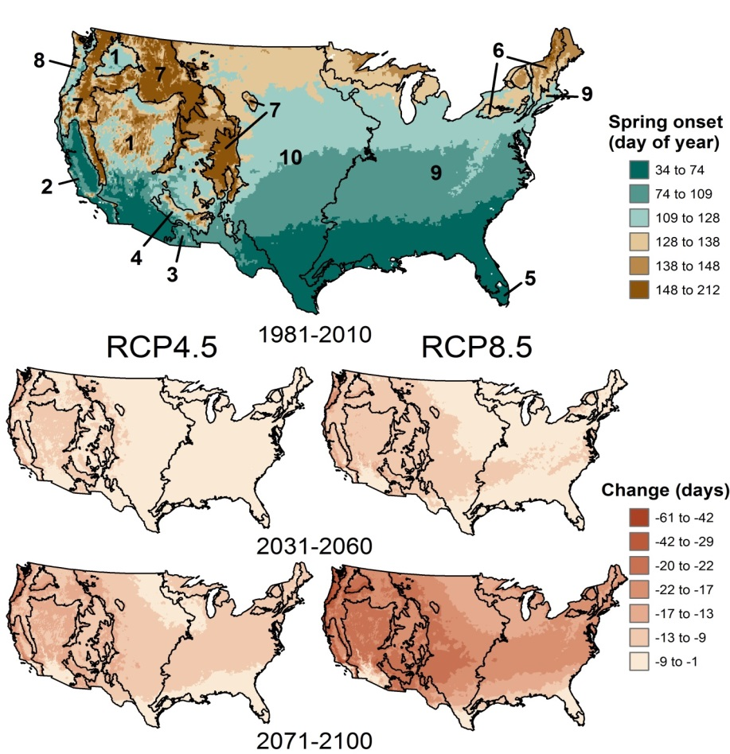
Allstadt et al.

Slide 11
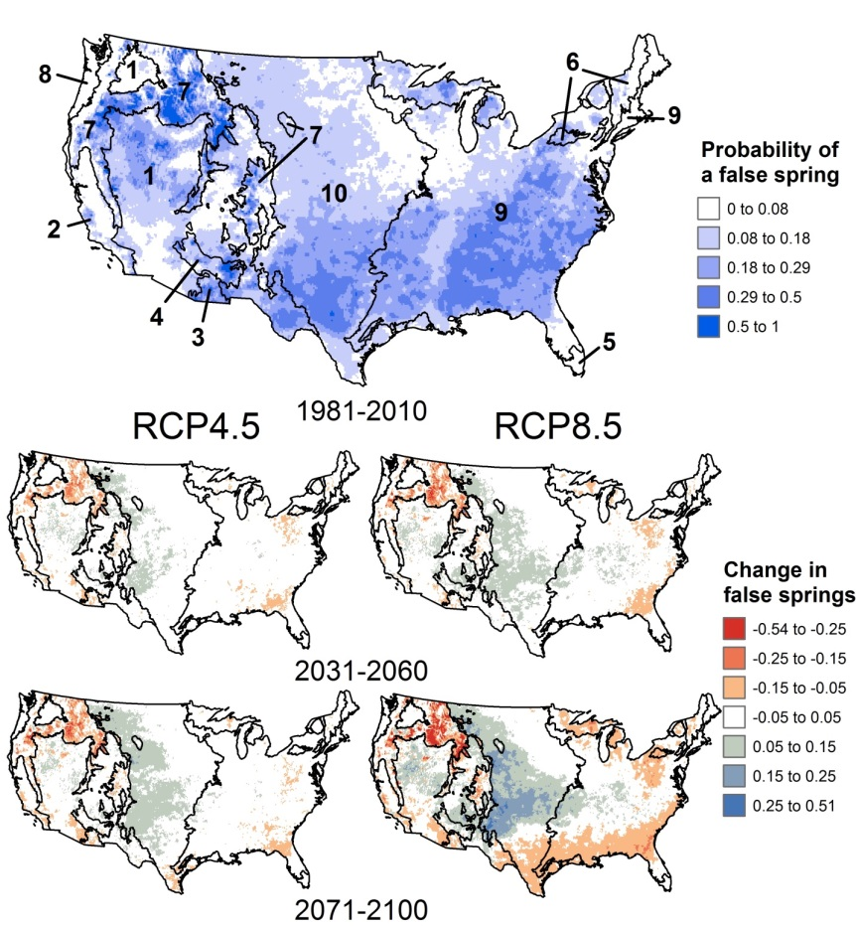
Allstadt et al.

Slide 12
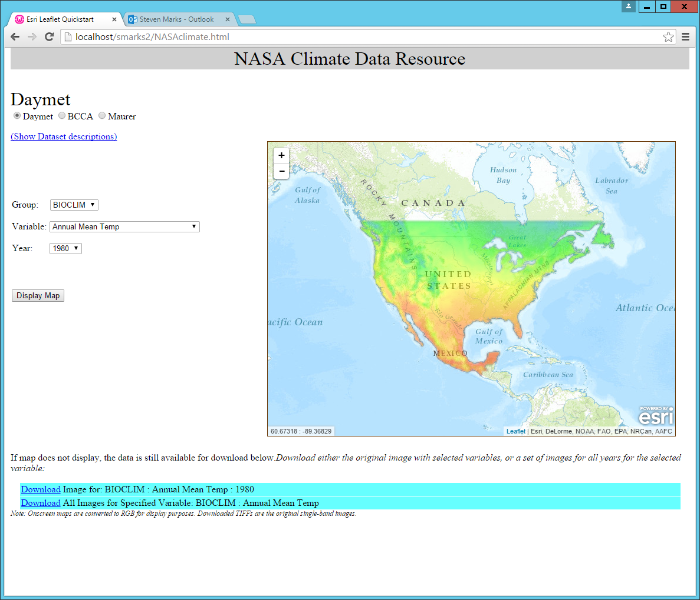
Extreme weather data
Extreme Climate Data Resource
Allstadt et al.

Slide 14
Extreme heat
Martinuzzi et al.

Slide 15
Droughts
Martinuzzi et al.

Slide 16
National Wildlife Refuges
Martinuzzi et al.
Notes:
Description: the figures show the changes in the frequency of false springs and droughts by the 2050s under the RCP 4.5 scenario. I used three classes to describe changes: more frequent, less frequent, and no change. Changes in extreme warms are not shown because is all “more frequent”.
Description of the classes. “More frequent” means changes in frequency >20%, less frequency means changes <-20%, and no change is between -20% and 20%. By definition, the frequency of droughts and extreme warms in the baseline period is 5% or 1 every 20 years. Thus, a change >20% mean that the change needs to be >4 years (positive or negative) in order to be in the more frequent or less frequent category. For example, if the frequency changes from 1 every 20 years in the baseline to 1 every 15 years in the future, the I classified as more frequent. If it goes from 1 every 20 years to 1 every 27 years, it is less frequent. But it goes from 1 every 20 years to 1 every 17 years, then it is with the “no change” class (because the changes is smaller than 20%).
For the false springs, however, there is one modification. I used the 20% threshold to separate the classes of change, same as above. However, the frequency of false springs in the baseline varies by region, i.e. it is not once every 20 years everywhere, as with the other two variables. What I did here, is I only considered for the analysis of change those refuges that experience at least one false springs every 30 years in the data (30 years is the time period of the projections e.g. 2041-2070). I did this because there are some refuges with extremely low frequency of false springs, such as once every 100 years, and analyzing changes in these won’t change the fact that they will still be extremely infrequent. Thus, for false springs, the class “no change” includes refuges with extremely infrequent false springs. I will be happy to discuss these more with you! I am open for questions and modifications.

Slide 17
National Wildlife Refuges
Martinuzzi et al.
Notes:
These are all the combinations projected by 2050 under rcp 4.5. I will probably modify the legend for a final version, using symbols (+ - =) so to have less text, but I want to make sure the approach is ok first.

Slide 18
Extreme event
Die
Move
Chicks
Adults
Emigrate
Concentrate

Slide 20
Bateman et al.

Slide 21
Bateman et al.

Slide 22
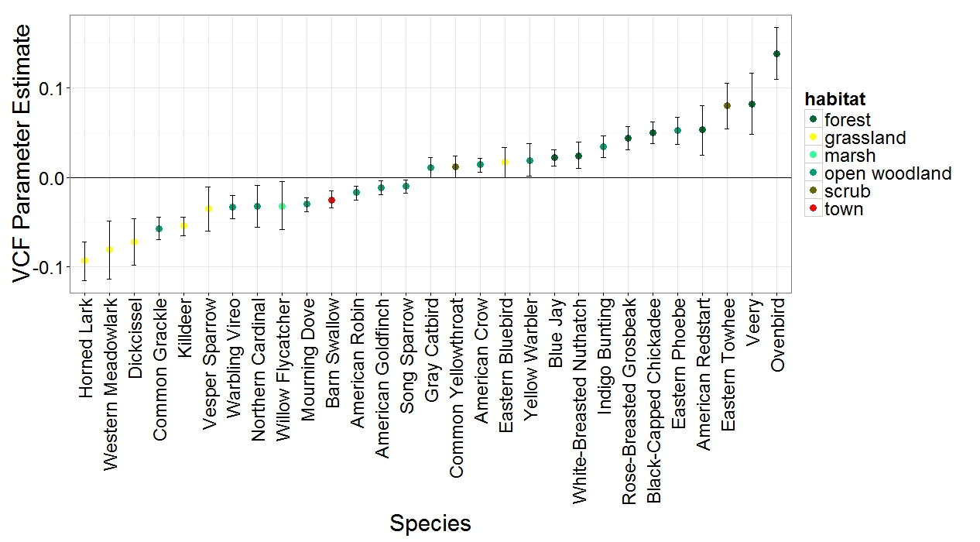
Birds and Vegetation Continuous Field
Habitat affiliation
grassland/ag
shrub/woodland
forest
generalist
Gorzo et al.

Slide 23
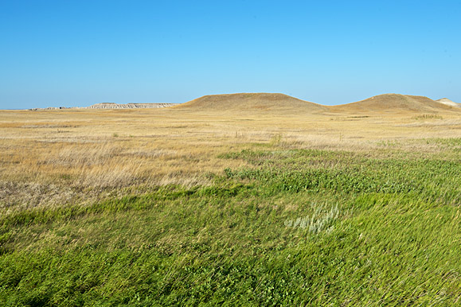
Grassland birds
 | Drought | Heat | Interaction
Upland Sandpiper | X
Baird’s sparrow | X
Sprague’s Pipit | X | X
Vesper sparrow | X | X
Grasshopper Sp. | X | X | X
Horned Lark | X | X | X
Western Meadowlark | X | X | X
Gorzo et al.

Slide 24
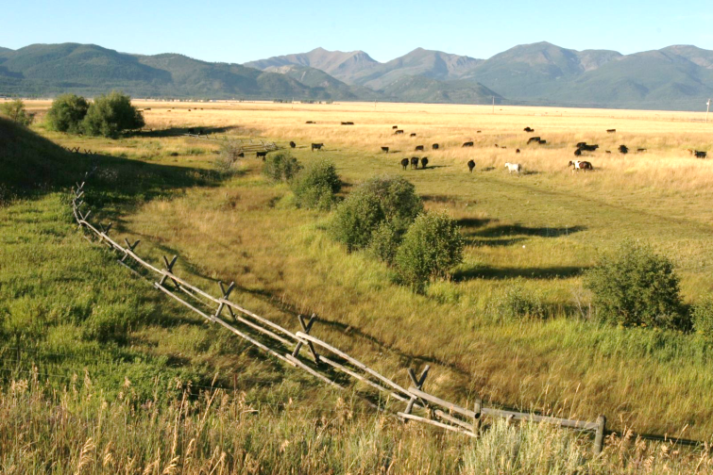
Shrub nesters
 | Drought | Heat | Interaction
Mourning Dove | X
Clay-colored Sp. | X
Field Sparrow | X | X
Lark Sparrow | X | X | X
Brewer’s Blackbird | X | X | X
Brown-headed Cowbird | X | X | X
Gorzo et al.

Slide 25
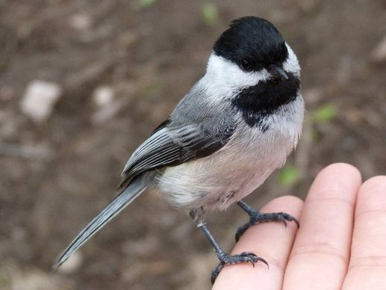
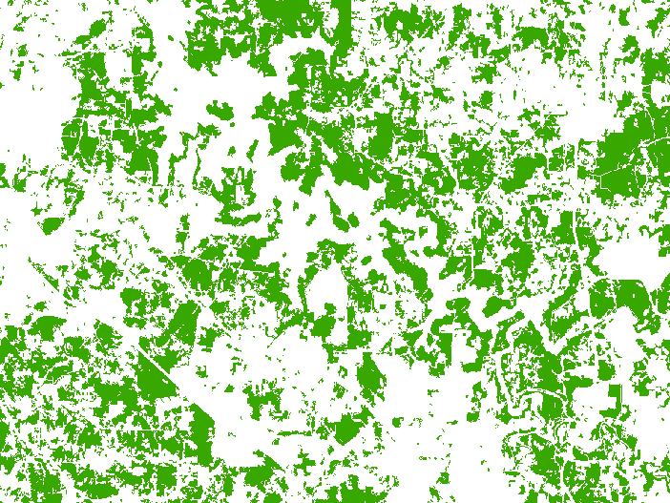
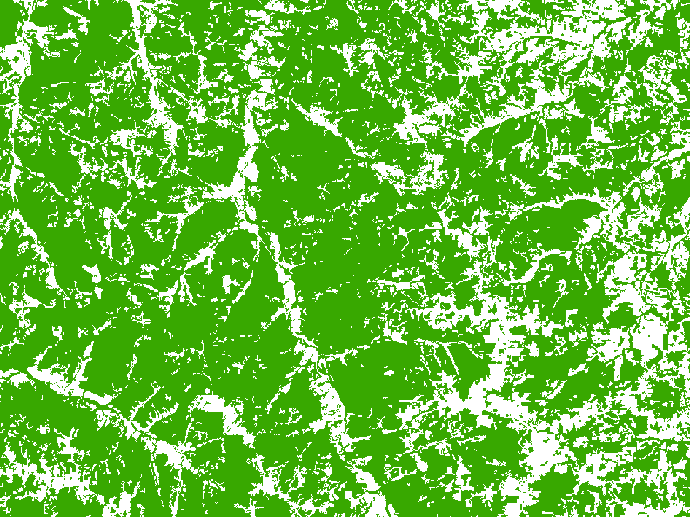
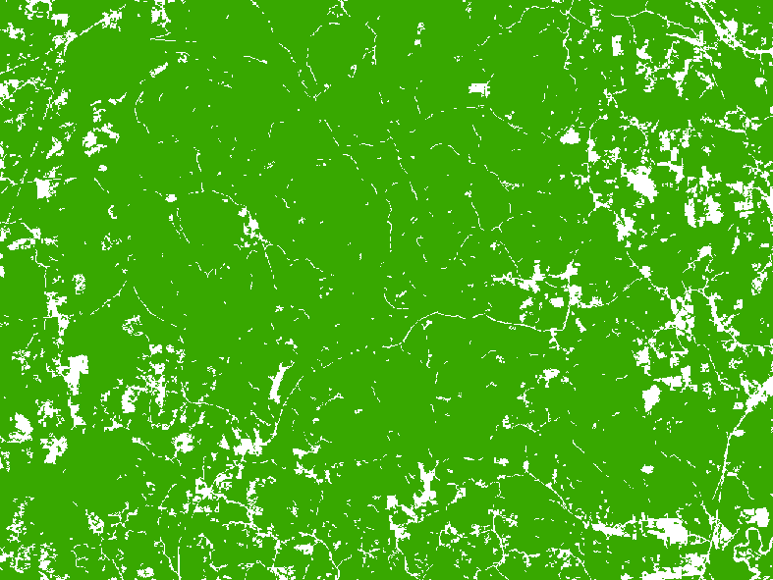
Extreme weather and forest fragmentation
Average no. dry days
High frequency of dry days
Venegas et al.
Notes:
Black-capped Chickadees are a species that requires forest, or at least lots of trees (e.g. in mature suburbs).
In years with ‘typical’ or average weather, juvenile recruitment of black capped chickadees did not differ in fragmented versus unfragmented forests. But in years with lower than average precip, recruitment was higher in unfragented than fragmented forest.
Large unfragmented blocks of forest may be better because:
they have more humid interiors, and the soft bodied invertebrates (and for that matter many invertebrates) reach higher densities in these conditions than in edge –of-forest sites that are dryer/less humid.

Slide 26
Extreme event
Die
Move
Chicks
Adults
Emigrate
Concentrate

Slide 27
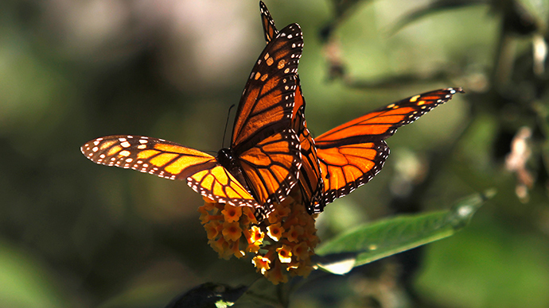

Slide 28
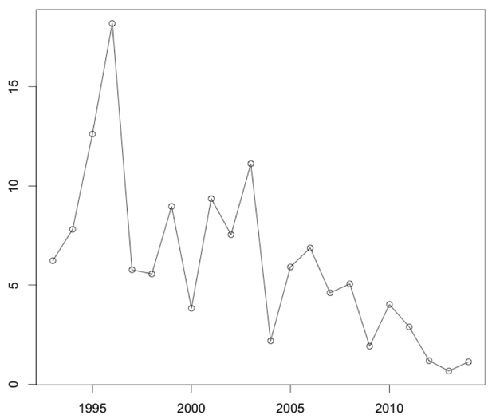
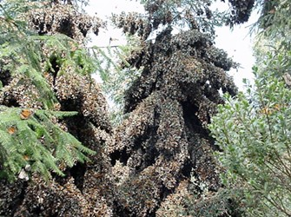
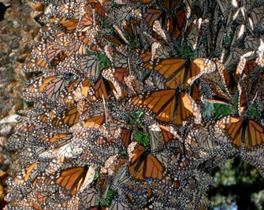
Monarchs declined by 90% in 20 yrs.
Total area covered by overwintering colonies each year
Overwintering Area (Ha)

Slide 29
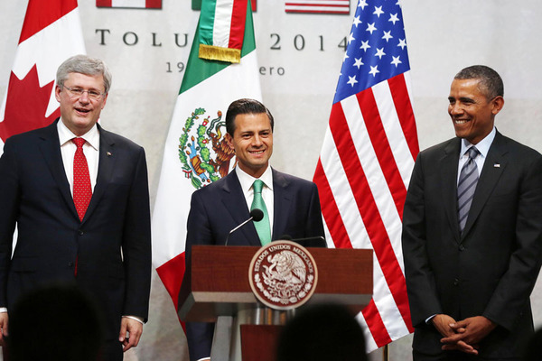

Slide 30
“We have also agreed to work on the preservation of the Monarch butterfly. It is a landmark species in North America. “…. we have agreed to work a taskforce … to preserve the Monarch butterfly”

Slide 31
Monarchs
FWS petitioned to list Monarchs as Threatened
EPA sued because of “unreasonable adverse effects [of glyphosate] on the environment”, particularly Monarchs

Slide 32
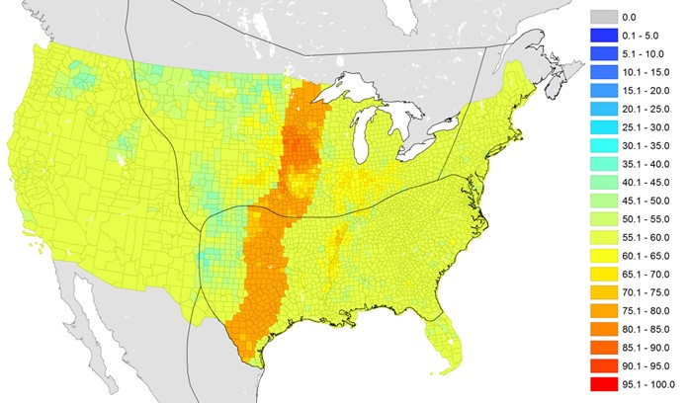
Monarch prairie passage

Slide 33
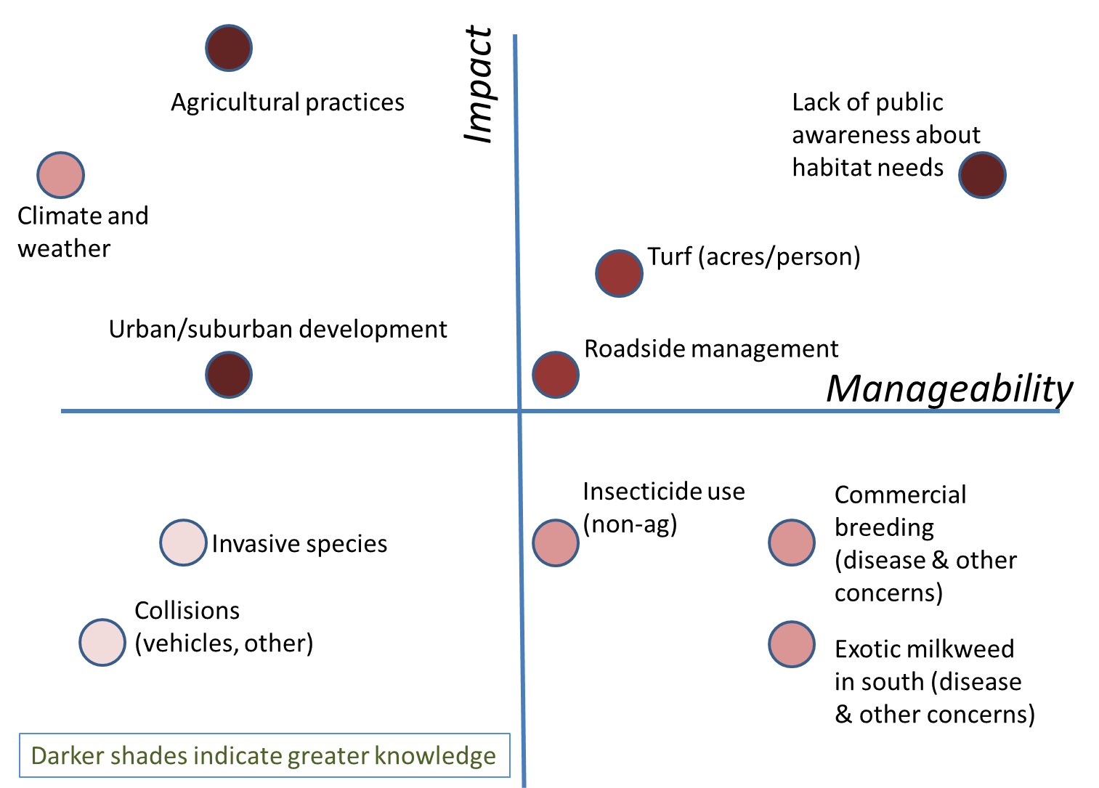
Weather variability
Monarch Conservation Science Partnership
Threats Assessment

Slide 34
April 2004
Bateman et al.

Slide 35
April 2008
Bateman et al.

Slide 36
April 2013
Bateman et al.

Slide 37
Extreme event
Die
Move
Chicks
Adults
Emigrate
Concentrate

Slide 38
Conclusions
What are fine-scale patterns of climate extremes?
Which refuges will see increases in which extremes?
How did and how will birds respond to extremes?
And what about Monarch butterflies?

Slide 39
Thank you!

